Slide 1
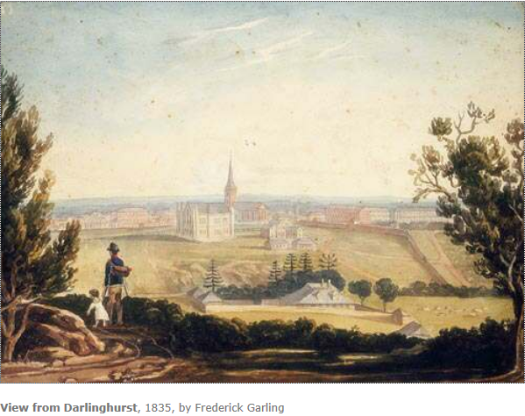
What is the Story of the Catholic Church in Australia?

Slide 2
What is the Story of the Catholic Church in Australia?
Generating inquiry questions for our unit
When did the first Catholics arrive in Australia?
Where did they come from?
Who were some key figures in the early Australian Catholic community?
What challenges did they face?
Come up with one more inquiry question of your own that you
you would like to find out about. Write your question in the space provided on your inquiry worksheet.

Slide 3
It all began in Britain...
During the 1700s, living conditions were very difficult in Britain. This led to a rise in crime, with governments introducing harsh laws and severe punishments. A person could be gaoled for stealing a loaf of bread to feed a hungry family.
Prisons became so crowded that old ships were used to house prisoners.
Catholics were treated very harshly. They could not own land, vote, attend Mass, receive a university education or hold public office.

Slide 4
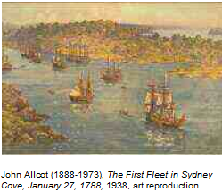
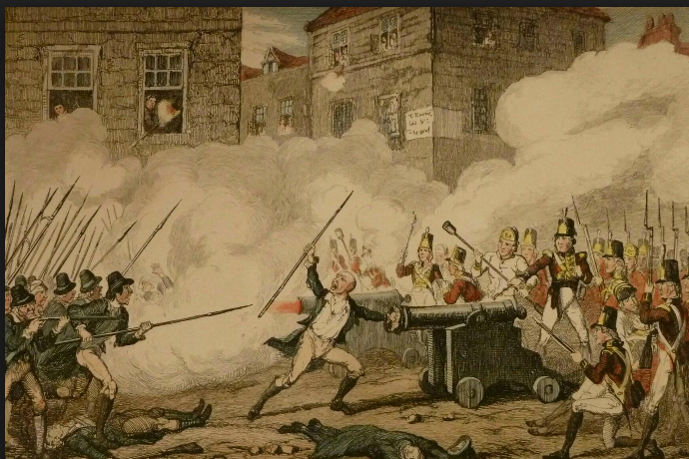
Transportation to New South Wales
In 1788 the First Fleet landed in Australia, carrying many prisoners from the overcrowded gaols of Britain.
In 1798 many Catholics in Ireland rebelled
against England. The rebellion was violent
and the Irish rebels were imprisoned
and transported to far-off Botany Bay
to join the convicts who had been sent
ten years earlier on the First Fleet.
The Irish Rebellion

Slide 5
Complete the first two answers on your inquiry sheet using the information below
The first Catholics to reside in Australia arrived with the First Fleet in 1788.
They were mostly Irish convicts, with others from England and Scotland.
Of the 1,044 convicts who arrived, 316 were Catholics.
www.catholicaustralia.com.au

Slide 6
A Hard Start
The new colony did not allow Catholics to practice their religion. Instead, they were forced to take part in Church of England services.
Catholics were not allowed to celebrate Mass, as the authorities believed if the Irish gathered together they would cause trouble.
Click here to take a short quiz on the beginnings of the story

Slide 7
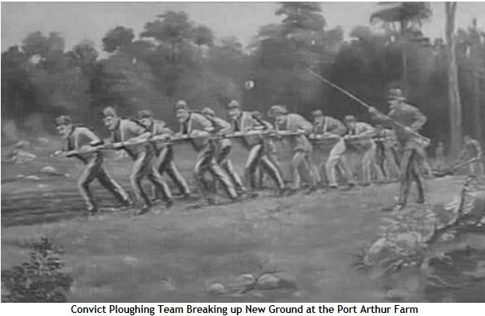
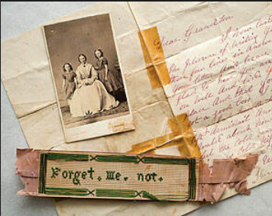
Your task
Imagine you are a Catholic Irish convict who was transported to New South Wales. Write a letter to your family in Ireland describing your feelings about your life in the new colony.

Slide 8
The first priests
There were no priests in the colony of New South Wales, so the Irish convicts had to keep their faith alive themselves.
There were no priests to provide them with Church teachings or sacraments.
One of the first Catholic priests to arrive in Australia was an Irish convict named James Dixon, who was sent to the colony on the ‘Friendship’ in 1800 for being suspected of taking part in the Irish Rebellion.
Father Dixon was not allowed to act as a priest until 1803, when Governor King decided having Mass might improve the behaviour of the Irish convicts.
The first public Mass ever celebrated in Australia was held on 15 May 1803 by Father Dixon.

Slide 9
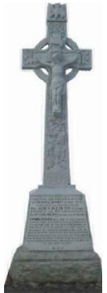
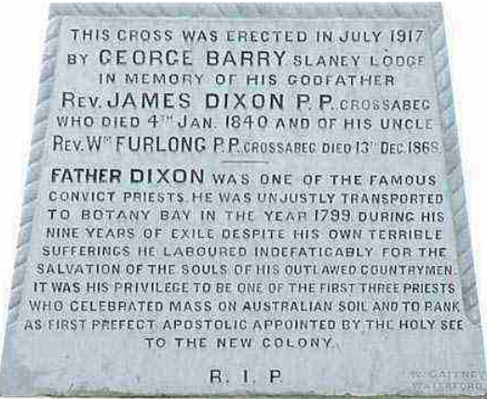
Father James Dixon
In 1804 when Rome found out about his work, Fr. Dixon was made 'Prefect Apostolic' of New Holland and thus became the first formal appointment by the Church in Australia.
In 1809 he returned to Ireland, where he remained until his death on January 4th 1840.
During a visit to Ireland in 2009 the Archbishop of Sydney, Cardinal George Pel, visited the grave of Fr. Dixon. This was a historic moment in which the leader of the Church in Australia visited, for the first time, the grave of the 'convict priest' who celebrated the first Mass on Australian soil.
http://www.crossabegballymurn.ie

Slide 10
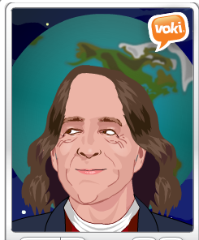
Father James Dixon
Using what you now know about Father Dixon, work with a partner to create a Voki who will answer this question:
Why is Father Dixon known as the ‘founding father’ of Catholicism in Australia?
Include all of the details that you know and make sure your Voki speaks in full sentences.

Slide 11
The Official Start
Australia's Catholic Church officially began with the arrival of two chaplains sent by the British Government.
Use the information found here to complete your cloze worksheet. You can find this website on 2 Clicks.

Slide 12
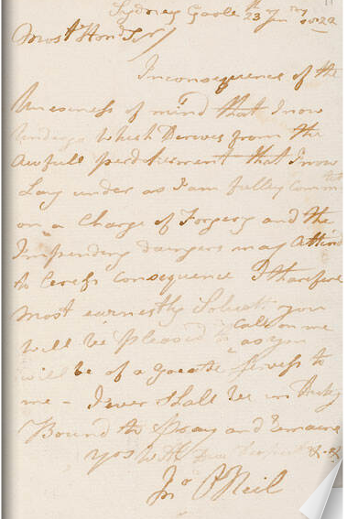
Father Therry
Father Therry found the work in New South Wales extremely difficult, but he never gave up.
His work was wanted and respected by the Catholic convicts and many letters were written to him asking for his help. These letters are held in the NSW State Library today. They are a source of evidence of the trust the convicts placed in him.
Father Therry died in 1864 and his funeral was the biggest to have ever occurred in Sydney to that date.
Click here to see some of the letters written to Fr Therry by the convicts.

Slide 13
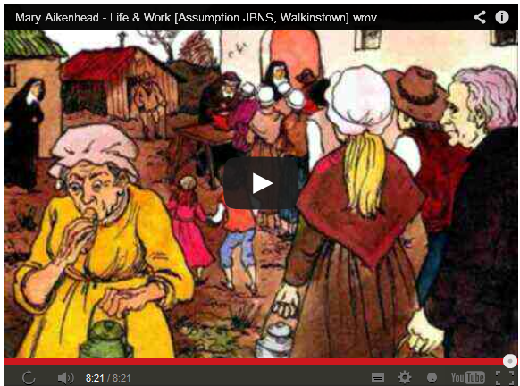
Sisters of Charity
Watch this video to learn about the Sisters of Charity and their founder, Mary Aikenhead.

Slide 14
Sisters of Charity
Research the Sisters of Charity at http://www.sistersofcharity.org.au/yesterday/ourstory/ (2 Clicks)
Construct a timeline that shows key dates in the beginning of this order in Australia.
Include an entry for 2013 that shows the work they continue to do today.

Slide 15
Reflect on Learning
Using what you now know about the story of the early Catholic Community in Australia, fill out your inquiry sheet with as much detail as possible.

